Slide 1

Welcomes you to the World of Software Solutions!
Bluebase Software Services is engaged in Development customized IT Solutions. We have built web-based applications and mobile applications to meet the customer requirements. We cater to the needs of customers to their satisfaction. We use open source technologies to lower the cost of ownership without compromising Quality, Security and Ease of use.

Slide 2

OUR SOLUTIONS
Enterprise Mobility
Analytics for All
ERP Solutions
RPA Solutions
Industrial IOT
Web Portal Solutions
Brand Building
Artificial Intelligence
Data Science
Digitization
Canteen Management
Hospital Manangement
Hotel Management
Asset Management
Contract Labour Management
Banking
HRMS
www.bluebase.in

Slide 3

Enterprise Mobility
www.bluebase.in

Slide 4
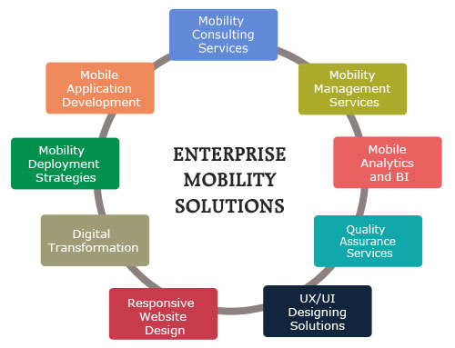
www.bluebase.in

Slide 5

contract labour management
www.bluebase.in

Slide 6
contract labour management
Contract labour management system helps organization in managing contract labourer’s.
Paper free Agreements.
Biometric Fingerprint Technology where all the labour will be registered with their Fingerprint and other details which can be used for verification as well and only the authorized labours will be allowed to enter into the premises.
Manage the data of all the labours like License, EC policy, GPA, ISMW policy.
Contractors Overtime and Shifts are tracked regularly based on IN/OUT punches.
www.bluebase.in

Slide 7
contract labour management
Registration of the labours, Contractors & Company details.
In and out attendance through various means of Biometric.
Details like ESI, GPA, PF, blood group, photographs, Period of Contract are incorporated in the ID card.
Standard Reports of contract employees like attendance, Holiday, Work Permit, Deviation and Overtime.
Compliance and tracking of Working Time Directive.
In case of accident / threat, man count & individual details can be traced
www.bluebase.in

Slide 8

ANALYTICS FOR ALL
www.bluebase.in

Slide 9
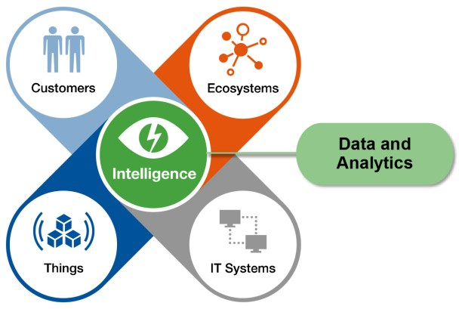
ANALYTICS FOR ALL
www.bluebase.in

Slide 10

ERP SOLUTIONS
www.bluebase.in

Slide 11
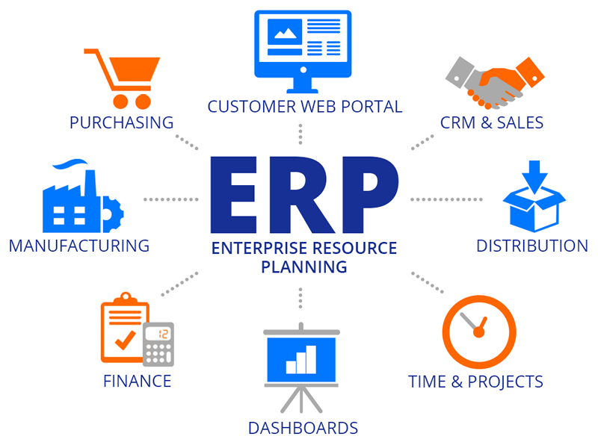
www.bluebase.in

Slide 12

RPA SOLUTIONS
www.bluebase.in

Slide 13
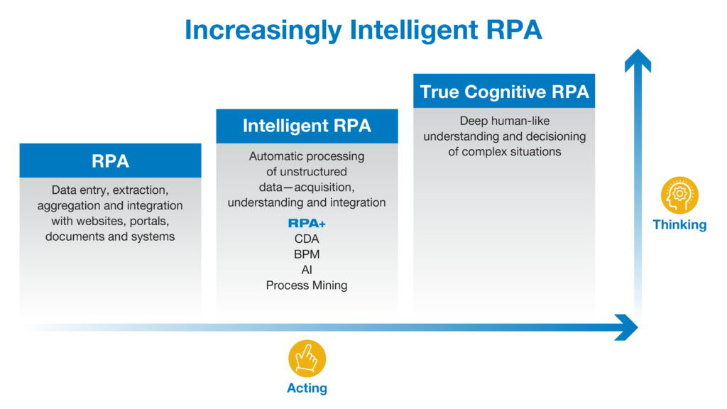
ROBOTIC PROCESS AUTOMATION
www.bluebase.in

Slide 14

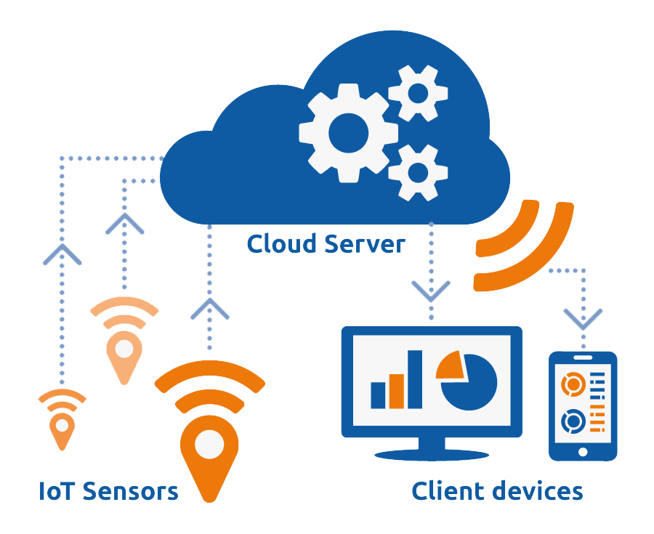
Industrial iOT
www.bluebase.in

Slide 15
INDUSTRIAL INTERNET OF THINGS
IoT is an advanced automation and analytics system.
Exploits networking, sensing, big data and artificial intelligence technologies to a system making it a high performing, connected, controlled system.
Industrial IoT takes the concepts of IoT and applies it to any industry resulting in a highly efficient automated manufacturing plant.
www.bluebase.in

Slide 16

web portal solutions
www.bluebase.in

Slide 17
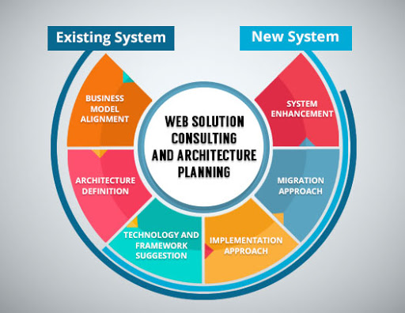
web portal solutions
www.bluebase.in

Slide 18

www.bluebase.in

Slide 19

Artificial Intelligence
www.bluebase.in

Slide 20

Data Science
www.bluebase.in

Slide 21
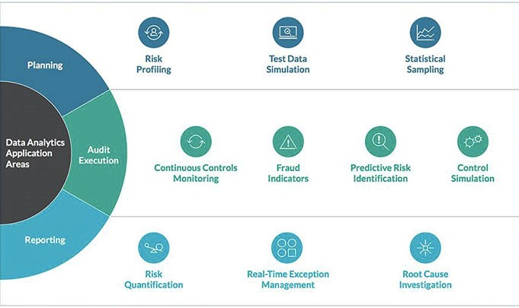
Data Science
www.bluebase.in

Slide 22

Brand Building
www.bluebase.in

Slide 23
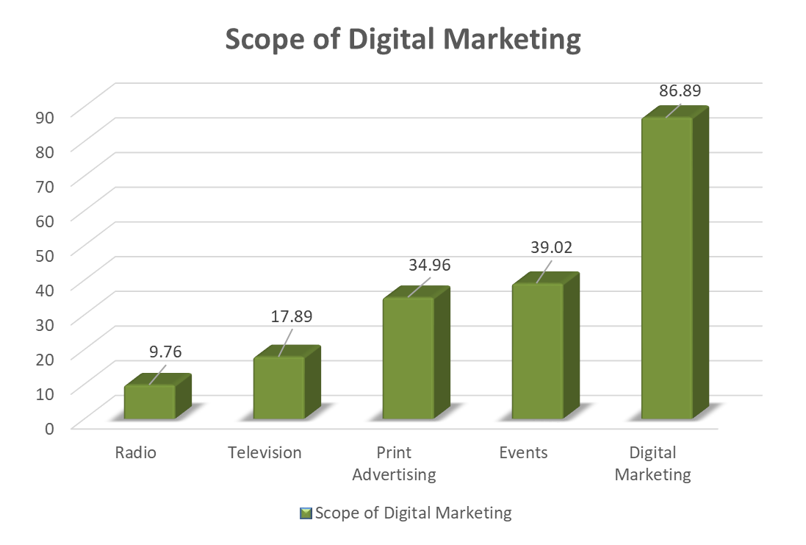
www.bluebase.in

Slide 24




CONTENT WRITING
WEBSITE DEVELOPMENT / REVAMPING
SEARCH ENGINE OPTIMISATION / MARKETING
SOCIAL MEDIA OPTIMISATION / MARKETING
www.bluebase.in

Slide 25


SMO Post Content
Services Post
Inspirational Quote Post
Fact Post
Blog Post
About us / Contact us Post
Website Content Development
SEO Based Content
Blogs Writing
Blogs for Site
Blog Post
CONTENT WRITING
www.bluebase.in

Slide 26


Slide 27

NEW RESPONSIVE
Website Development (SEO Based)
Exsiting Website Revamping (SEO Based)
www.bluebase.in

Slide 28

www.bluebase.in

Slide 29

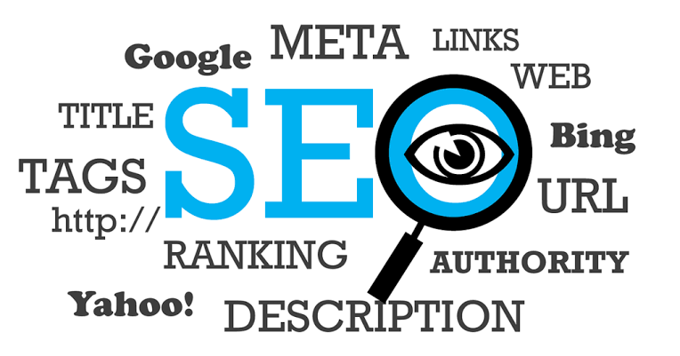
SEO & SEM
SEO – Search Engine Optimisation
Search engine optimization (SEO) is the process of optimizing your online content so that a search engine likes to show it as a top result for searches of a certain keyword
SEM – Search Engine Marketing
In Internet marketing, search advertising is a method of placing online advertisements on web pages that show results from search engine queries. Through the same search-engine advertising services, ads can also be placed on Web pages with other published content.
www.bluebase.in

Slide 30

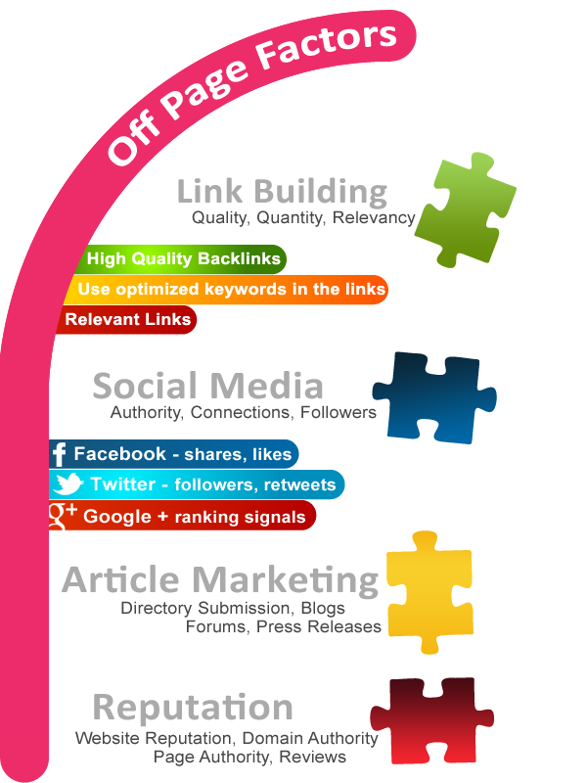
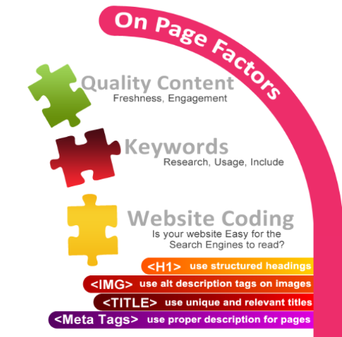
www.bluebase.in

Slide 31


SMO & SMM
Social media optimization (SMO) is the process of increasing the awareness of a product, brand or event by using a number of social media outlets and communities to generate viral publicity.
Social media marketing refers to the process of gaining traffic or attention through social media sites. Social media itself is a catch-all term for sites that may provide radically different social actions.
www.bluebase.in

Slide 32

digitization
www.bluebase.in

Slide 33
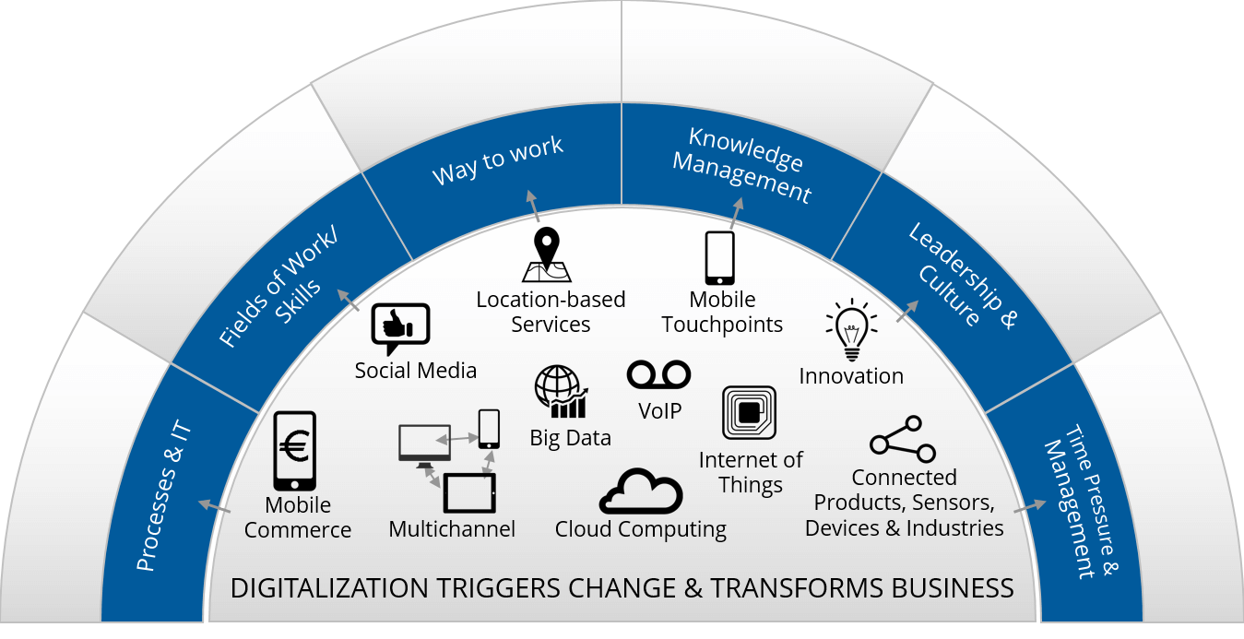
digitization
www.bluebase.in

Slide 34

canteen management
www.bluebase.in

Slide 35
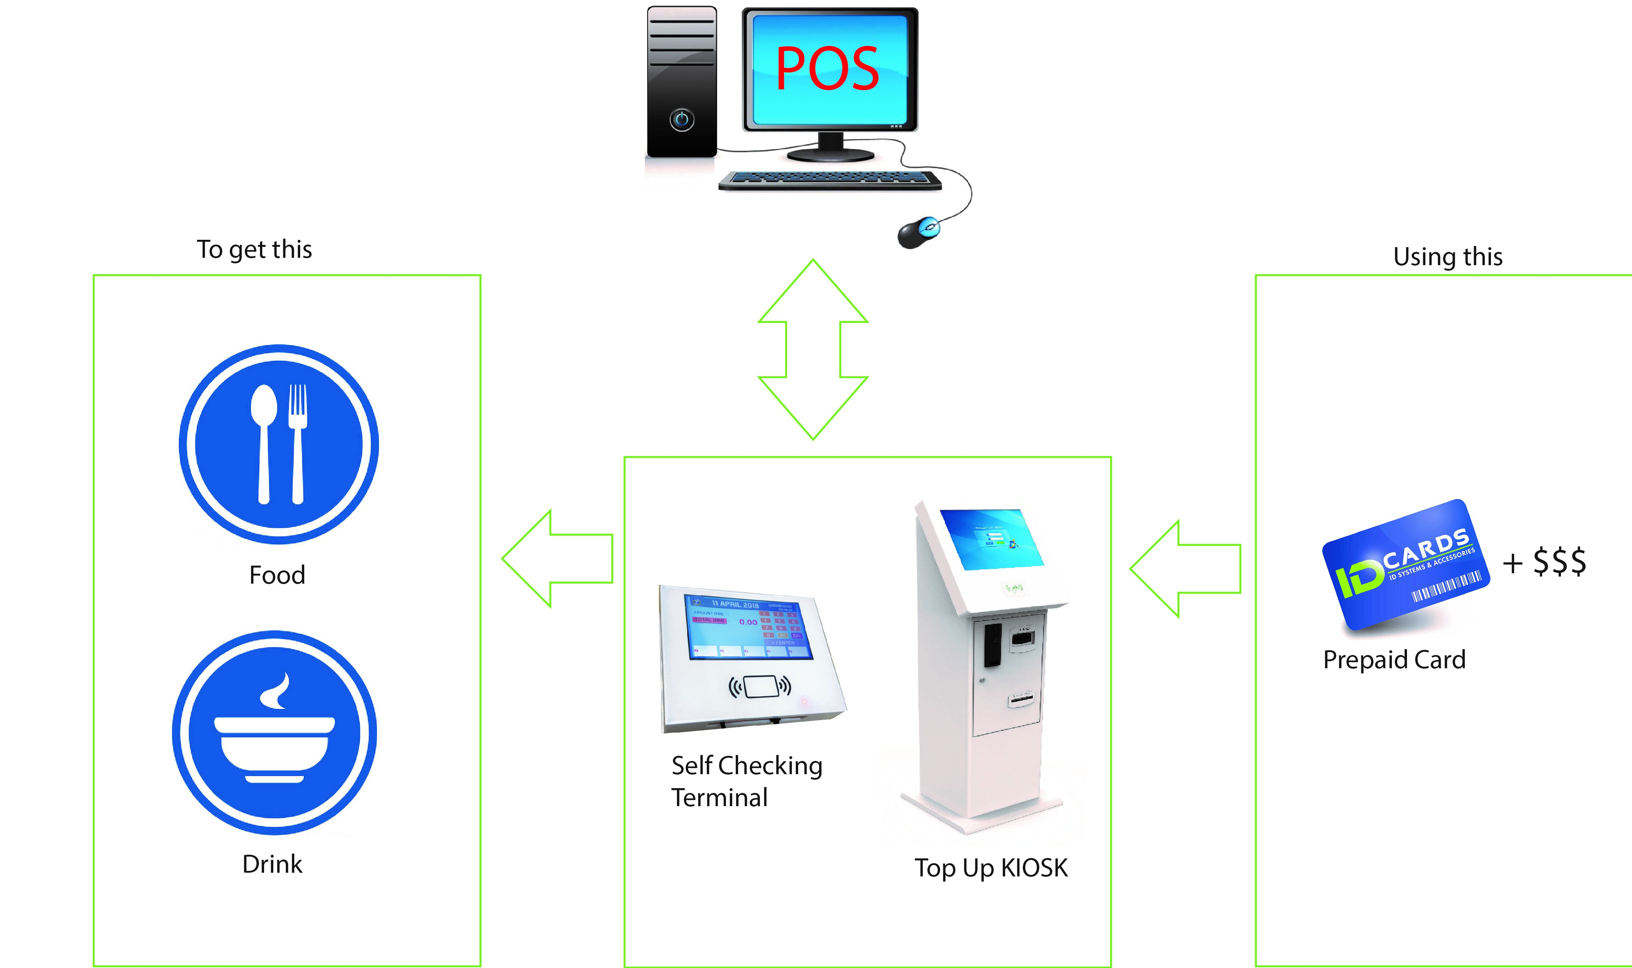
canteen management
www.bluebase.in

Slide 36
hospital management
www.bluebase.in

Slide 37
MANAGE HEALTHCARE DIGITALLY
Hospital
Laboratory
Clinic
Pharmacy
Patient Portal

Slide 38
MANAGE HEALTHCARE DIGITALLY
OUT-PATIENT MANAGEMENT
IN-PATIENT MANAGEMENT
LAB / DIAGNOSTIC MANAGEMENT
PHARMACY / INVENTORY MANAGEMENT
ASSET MANAGEMENT
INSURANCE MANAGEMENT
www.bluebase.in

Slide 39

hotel management
www.bluebase.in

Slide 40
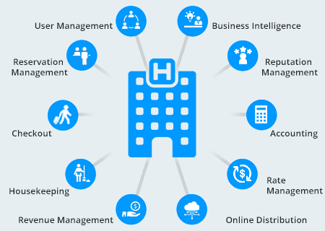
hotel management
www.bluebase.in

Slide 41
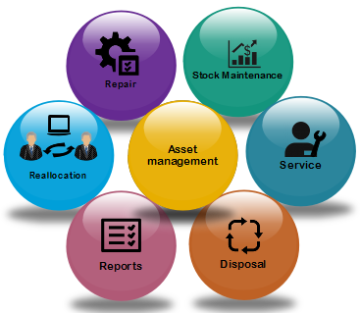
asset management
www.bluebase.in

Slide 42
asset management
Asset management software is all about keeping track of every asset a company owns.
System track organisation assets by item, category, brand, repair history, asset specifications, owners, purchase cost and claim damages.
Asset requests are handled using workflows to obtain approvals, validate entitlements, issue chargebacks, and provision services.
www.bluebase.in

Slide 43
asset management
Maintain asset lifecycle from procurement to disposal.
Visibility and information on available resources, based on manufacturer, model.
User wise inventory List.
Provisions for re-allocation.
Maintain and track Warranty, Stock Maintenance details, Purchase details, Annual Maintenance, Configuration updation and various reports.
www.bluebase.in

Slide 44

Banking
www.bluebase.in

Slide 45
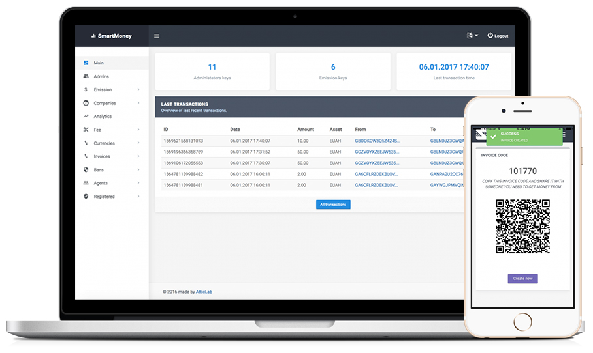
Banking
www.bluebase.in

Slide 46

hrms
www.bluebase.in

Slide 47

OVERVIEW
Human Resource Management System Centralizes HR Function and Connects The Organization, Managers and Employees on One Platform.
HRMS Integrates all Aspects of An Employee Lifecycle - from Induction to Separation.
Deals with HR Functions like Storing Employee Data, Generating Pay Slip, Maintain Attendance Records, Analyzing Performance of Employees, Leave Management and Activity Record of Each Employee.
www.bluebase.in
Notes:
Lesson descriptions should be brief.

Slide 48
FEATURES
Maintain Employees Data Effortlessly
Easy Tracking of Time and Attendance Integrated with Biometric Reader
Simplify Employee’s Performance Reviews
User Friendly
Powerful Reporting
Secure Self Service Portal
www.bluebase.in
Notes:
Example objectives
At the end of this lesson, you will be able to:
Save files to the team Web server.
Move files to different locations on the team Web server.
Share files on the team Web server.

Slide 49
WHY BLUEBASE?
You
Your Customer
Customer
Business
Communication
Satisfaction
We
Brand Building
Brand Awareness
Customer Engagement
User Experience
www.bluebase.in

Slide 50


Awareness is best at launching a new company, new flavor or a new model. It’s also great at introducing a current brand into a new market or product category.
Brand Building is most effective at keeping current customers “in love” with your brand and to deepen your value in their hearts that goes beyond the commodity and price wars.
www.bluebase.in

Slide 51


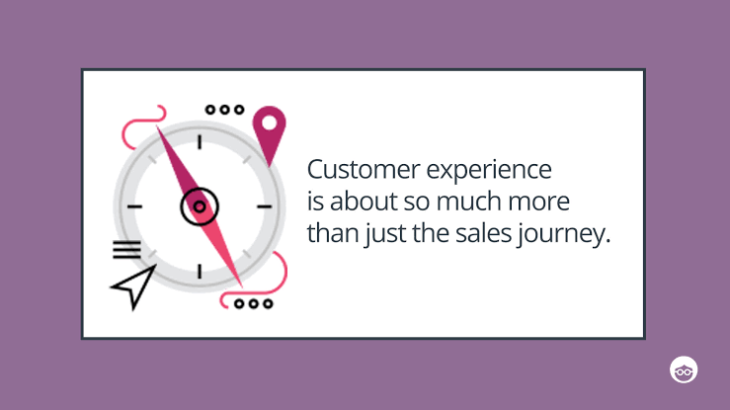
Customer engagement, if it happens, occurs earlier in the timeline.
Customer satisfaction usually (but not always) is a result of customer engagement.
www.bluebase.in

Slide 52

Our Team
Qualifications
Capabilities
Application Development.
Web : HTML, CSS
Frameworks : Phonegap, Android
Programming : PHP, Javascript
Library : Jquery
DB : MySQL, MongoDB, MS SQL.
Value ADD
Integration capabilities viz. Access control, PLC, RFID etc.
SAP Consulting, Support and maintenance.
Create Dashboards integrating your existing application data.
Post graduates
45%
Engineering Graduates
55%
Post Graduates
……………………………………………………
Experience Development
>10 Yrs
30%
0 – 5 Years
70%
www.bluebase.in

Slide 53













Our Esteemed Customers
The logos shown here are purely for illustration purposes and belong to the respective owners

Slide 54
CONTACT US
QUADSEL TOWER
Old No 80, New No 118
Anna Salai, Manickam Ln, Guindy,
Chennai - 600032.
+91 44 2250 2277
info@bluebase.in | www.bluebase.in

Slide 55
THANKYOU!

